Slide 1
Tame Your Unruly Data… With Constraints!
Rob Volk
Senior DBA

Slide 2



Rob
Volk
He/Him
Senior DBA
SQL Server user since 1998/v6.5. Atlanta SQLSaturday/DataSaturday organizer. SQLTeam forum moderator Currently living and working near Atlanta, GA, USA.
@sql_r
sqlteam.com
sql_r@outlook.com

Slide 3
Demo #0 – What can go wrong without constraints?

Slide 4
So, uh, yeah, let’s discuss why we need these constraint thingies…
Data Integrity
Reliability
Standardizing/consistency across systems
Data Warehouse and associated ETL
Performance

Slide 5
What are these constraint thingies…?
Domain Constraints
columns/attributes/fields
Entity Constraints
rows/records, with key/identifier
Relational Constraints
tables with references to other keys

Slide 6
Domain Constraints
Data Types
NULL / NOT NULL
CHECK
DEFAULT

Slide 7
Entity Constraints
PRIMARY KEY
UNIQUE
CHECK, but with multiple columns

Slide 8
Relational Constraints
FOREIGN KEY
Referenced (parent) table
Referencing (child) table, has key to referenced table
sort of like a background check on your data
Notes:
Think of buying a house: does the property being bought really exist? Is it legitimately for sale? Is the seller a real person? Is the buyer a real person? Do they actually have the money?

Slide 9
Documentation?
Let’s say, on the highly unlikely chance I inherit a database system that actually has constraints, how do I find them?
sys schema (views and functions)
INFORMATION_SCHEMA (old)

Slide 10
OBJECTPROPERTYEX()
Property name | Object type | Description and values returned
CnstIsClustKey | Constraint | PRIMARY KEY constraint with a clustered index. 1 = True 0 = False
CnstIsColumn | Constraint | CHECK, DEFAULT, or FOREIGN KEY constraint on a single column. 1 = True 0 = False
CnstIsDeleteCascade | Constraint | FOREIGN KEY constraint with the ON DELETE CASCADE option. 1 = True 0 = False
CnstIsDisabled | Constraint | Disabled constraint. 1 = True 0 = False
CnstIsNonclustKey | Constraint | PRIMARY KEY constraint with a nonclustered index. 1 = True 0 = False
CnstIsNotRepl | Constraint | Constraint is defined by using the NOT FOR REPLICATION keywords. 1 = True 0 = False
CnstIsNotTrusted | Constraint | Constraint was enabled without checking existing rows. 1 = True 0 = False
CnstIsUpdateCascade | Constraint | FOREIGN KEY constraint with the ON UPDATE CASCADE option. 1 = True 0 = False
IsCheckCnst | Any schema-scoped object | CHECK constraint. 1 = True 0 = False
IsConstraint | Any schema-scoped object | Constraint. 1 = True 0 = False
IsDefault | Any schema-scoped object | Applies to: SQL Server 2008 and later. Bound default. 1 = True 0 = False
IsDefaultCnst | Any schema-scoped object | DEFAULT constraint. 1 = True 0 = False
IsForeignKey | Any schema-scoped object | FOREIGN KEY constraint. 1 = True 0 = False
IsPrimaryKey | Any schema-scoped object | PRIMARY KEY constraint. 1 = True 0 = False
IsRule | Any schema-scoped object | Bound rule. 1 = True 0 = False
IsUniqueCnst | Any schema-scoped object | UNIQUE constraint. 1 = True 0 = False
TableHasCheckCnst | Table | Table has a CHECK constraint. 1 = True 0 = False
TableHasDefaultCnst | Table | Table has a DEFAULT constraint. 1 = True 0 = False
TableHasForeignKey | Table | Table has a FOREIGN KEY constraint. 1 = True 0 = False
TableHasForeignRef | Table | Table is referenced by a FOREIGN KEY constraint. 1 = True 0 = False
TableHasPrimaryKey | Table | Table has a primary key. 1 = True 0 = False
TableHasUniqueCnst | Table | Table has a UNIQUE constraint. 1 = True 0 = False

Slide 11
Demo: Additional Benefits
Performance
Data model documentation
Business rules documentation
Some extra thought

Slide 12
How/when to use constraints #1
When you create a new table:
What columns? (domain)
What types do they have?
What would be an invalid value in that column?
Does the type allow that value?
What happens if that value is missing/NULL?

Slide 13
How/when to use constraints #2
When you create a new table:
What makes 1 row unique from another? (entity)
What happens if there’s a duplicate row?
If related data, how to remove incorrect dupe?
Are there combinations of column values that are invalid?
Is there more than 1 column/factor that makes it unique?

Slide 14
How/when to use constraints #3
When you create a new table:
What other tables/entities do I need for it to work? (relational)
e.g. mortgage table
Property table – valid parcel of land, properly zoned for construction, or existing building fit for occupancy
Lender table – valid financial institution, licensed to do mortgages/property loans
Lendee table – living person, or corporate entity, proper credit rating, legally permitted to buy property
All 3 tables/entities are required to properly create a mortgage

Slide 15
Data Integrity…Demystified!
Deborah Melkin
https://youtu.be/j7NU0eoZEY0
https://youtu.be/r2gGMTVwofc
https://youtu.be/OJSBB0SChjI

Slide 16
Data Types!
Andy Yun (Every Byte Counts)
https://youtu.be/zSNEaCujxmE
Angela Henry (Data Types Do Matter)
https://youtu.be/1Pm25-0lwM8

Slide 17
Database Design!
Edward Pollack (Solving Problems Before They Start)
https://youtu.be/Iq6ZbAfp99A

Slide 18
But is this really necessary? Everyone has some bad data sometimes…
Ariane Flight 501 (16 bit integer overflow)
Mars Climate Orbiter (metric vs. US)
USS Yorktown (1997, divide by zero)
F-22 (crashes, Intl. Date Line)

Slide 19
Conclusion
Types and definition of constraints
Domain, Entity, Relational
Performance & integrity benefits of constraints
Use them!
Please!
I’LL PAY YOU!

Slide 20
References
Books
Defensive Database Programming by Alex Kuznetsov (PDF link below)
SQL Antipatterns: Avoiding the Pitfalls of Database Programming by Bill Karwin (Pragmatic Bookshelf)
Blogs/Sites
http://www.simple-talk.com/books/sql-books/defensive-database-programming/
http://www.simple-talk.com/sql/database-administration/constraints-and-the-test-driven-database/
https://sqlserverfast.com/blog/hugo/2007/03/can-you-trust-your-constraints/

Slide 22

Rob
Volk
He/Him
Thank you for attending!
@sql_r
sqlteam.com
sql_r@outlook.com

Slide 23
Presentation slide template
Thank you for taking part in the
PASS Data Community Summit 2022.
Any questions?
Please email Annabel.Bradford@red-gate.com

Slide 24
Contents Everything you need for your presentation
3 - Slide templates
7 - Icons and graphics for you to use
11 - Virtual backgrounds (optional)
14 - Slide examples

Slide 25
Slide templates Including essential slides and personalizing your title slide with icons

Slide 26
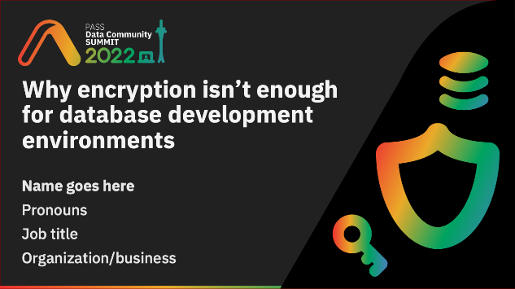

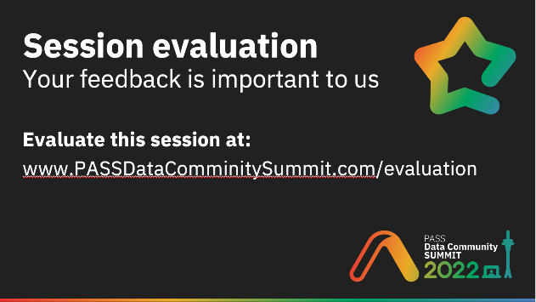
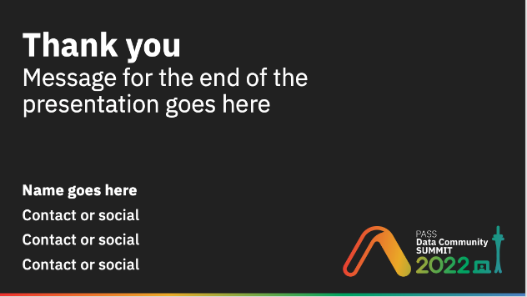
Slide templates Essential slides you must include in your presentation
Title slide
Speaker slide
Evaluation slide
Thank you slide

Slide 27
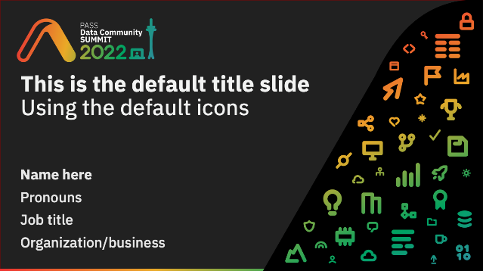
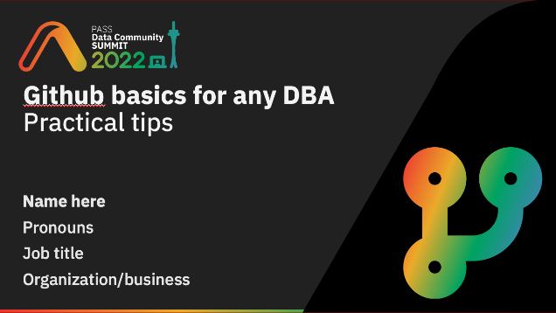
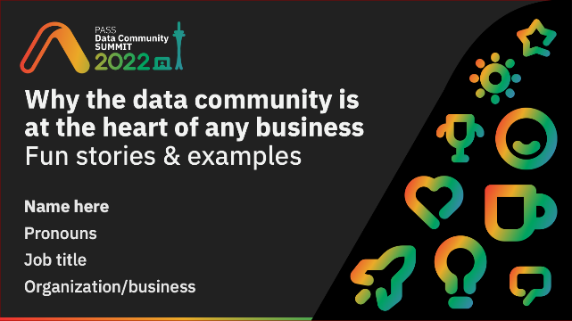

You can personalize your title slide using the icons provided on page 8, or you can simply use the default title slide. Examples:
Default title slide
Personalized
Personalized
Personalized
Please avoid overlapping the icons or the curve
Avoid distorting or rotating the icons
Have fun and use icons that relate to your session

Slide 28
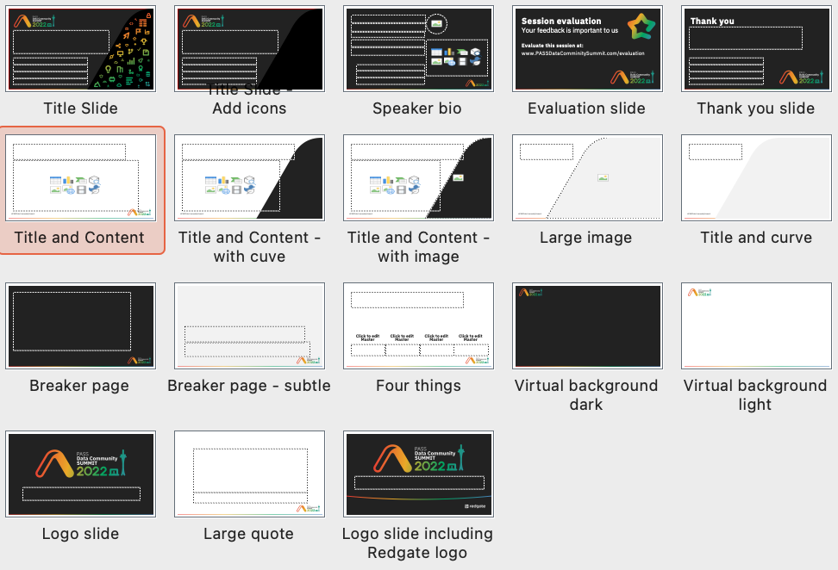
Other slide templates A variety of other slide layouts are provided

Slide 29
Icons and graphics You can use the provided icons and graphics throughout your presentation

Slide 30



























































Icons
A selection of icons for use in your presentations

Slide 31
Using the icons
The icons can be used big or small.
Please avoid overlapping or distorting the icons.
They can be used as bullet points
Just like they’re being used here
Keep them relevant to the point if possible

Slide 32






Other graphics you may find useful

Slide 33





Virtual backgrounds (optional) Create your own, and why not match it to your title slide

Slide 34







Virtual background examples

Slide 35
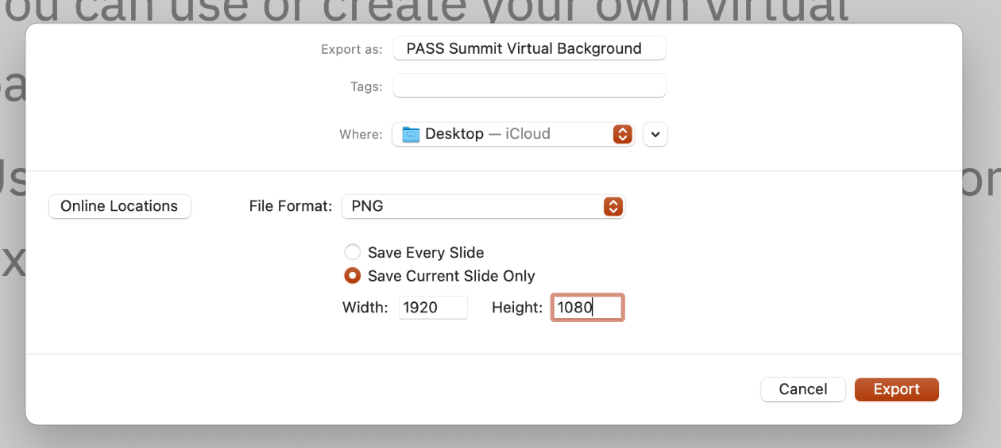
Create your own virtual background
Use the Virtual background slide layout
Add the icons from page 8
Avoid overlapping or distorting the icons
Export the slide as a png

Slide 36
Slide examples

Slide 37
Message for the end of the presentation goes here
Name goes here
Contact or social
Contact or social
Contact or social

Slide 39
Why the data community is at the heart of any business Fun stories & examples
Name here
Pronouns
Job title
Organization/business

